Slide 1
Digital Communication
Line Coding
Dr. M. Venu Gopala Rao
A.M.I.E.T.E, M.Tech, Ph.D(Engg)
Cert. in R.S.T ( City & Guild’s London Institute, London)
F.I.E.T.E, L.M.I.S.T.E, I.S.O.I., S.S.I., M.I.A.E.
Professor, Dept. of ECE, K L University
mvgr03@kluniversity.in

Slide 2
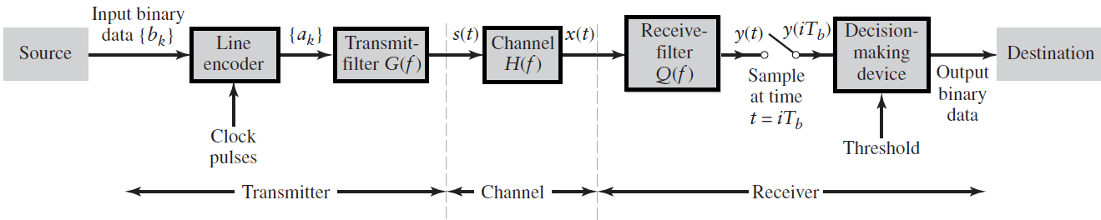
Binary Base-band data transmission System

Slide 3
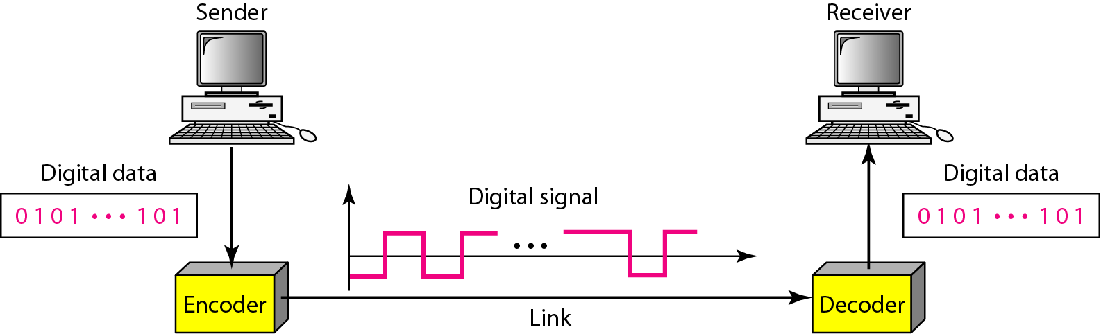
Line coding
PCM, DM, and DPCM converted analog signals into digital form.
Once a binary sequence of 1s and 0s is produced, a line code is needed for electrical representation of that binary sequence.
There are several line codes that can be used for this representation.

Slide 4
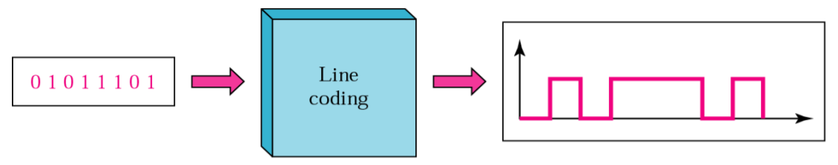
Line Codes
Binary digits (or bits) “0” and “1” are used simply to represent the information content.
They are abstract (intangible) quantities and need to be converted into electrical waveforms for effective transmission or storage.
There are several line codes that can be used for this representation, as summarized here.

Slide 5
Desirable Properties for Line Codes
Transmission Bandwidth: as small as possible
Power Efficiency: As small as possible for given BW and probability of error
Error Detection and Correction capability: Ex: Bipolar
Favorable power spectral density: dc=0
Adequate timing content: Extract timing from pulses
Transparency: Prevent long strings of 0s or 1s

Slide 6
Applications of Line Coding
NRZ encoding: RS232 based protocols
Manchester encoding: Ethernet networks
Differential Manchester encoding: token-ring networks
NRZ-Inverted encoding: Fiber Distributed Data Interface (FDDI)

Slide 7
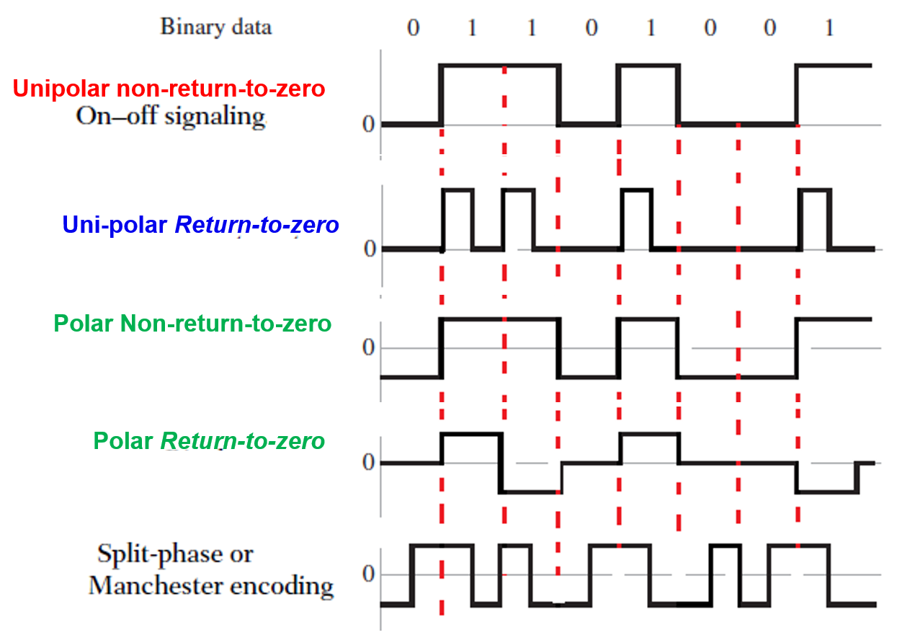

Slide 8
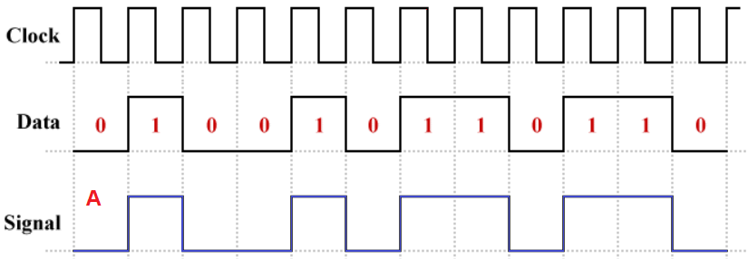
1. Unipolar Non-return-to-zero (NRZ) signaling
Symbol 1 is represented by transmitting a pulse of amplitude A for the duration of the symbol, and symbol 0 is represented by switching off the pulse.
The oldest unipolar line coding schemes are non-return-to-zero (NRZ) schemes in which the signal does not return to zero in the middle of the bit time.
Unipolar encoding uses only one voltage level.

Slide 9
Advantages and disadvantages
The advantages of unipolar NRZ are:
Simple to implement.
Requires relatively low bandwidth.
The disadvantages of unipolar NRZ are:
There is a significant DC component, which means that power is wasted due to heating of the wires in the transmission line.
It also means that channel links must be DC-coupled, because AC-coupled links will reject the signal's DC component.
There is no mechanism for embedding a clock signal into the line code.
Long sequences of ones or zeros can cause loss of synchronisation at the receiver due to the absence of voltage transitions.

Slide 10
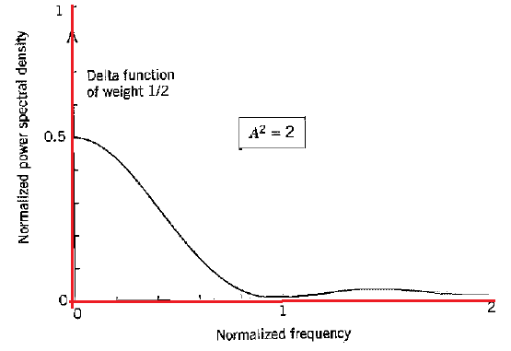
Uni-Polar Non-Return-to-Zero (NRZ) Signaling
Disadvantage: Waste of power due to transmitted DC level and the fact that the power spectrum of the transmitted signal does not approach zero at zero frequency.

Slide 11
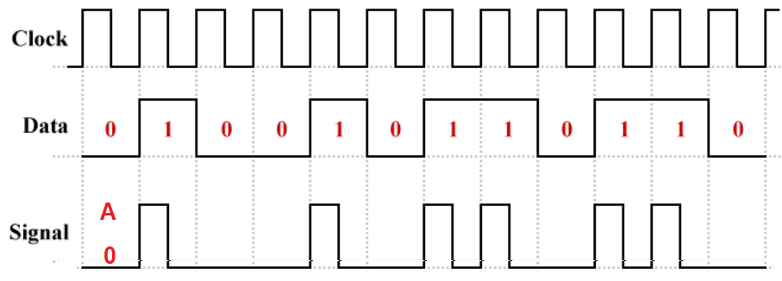
2. Uni-Polar Return-to-zero (RZ) Signaling
A return-to-zero (RZ) version of unipolar line coding in which the logic high (binary one) signal voltage returns to zero half-way through the bit time.

Slide 12
Unipolar-RZ
The advantages of unipolar RZ are:
Simple to implement.
The DC component is half that of unipolar NRZ.
The disadvantages of unipolar RZ are:
Requires twice as much bandwidth as unipolar NRZ.
Long sequences of zeros can still cause loss of synchronization at the receiver.
There is still a significant DC component, so some power is still wasted and AC coupling is still a problem.

Slide 13
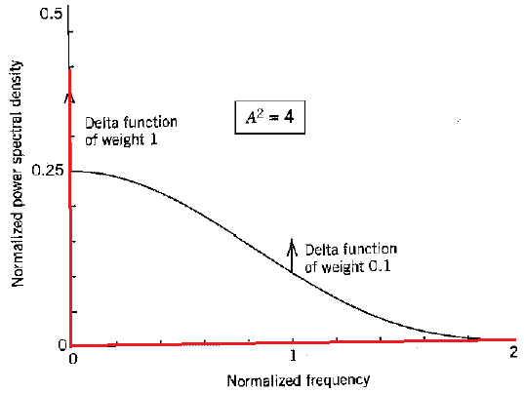
Unipolar-RZ
Requires twice as much bandwidth as unipolar NRZ.

Slide 14
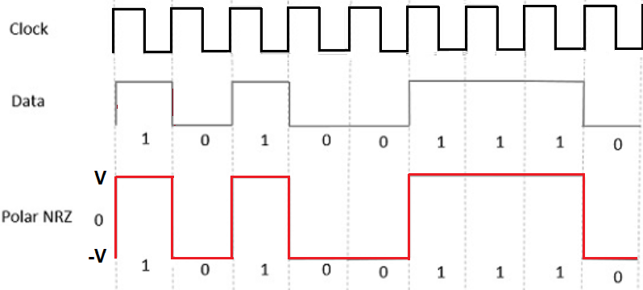
3. Polar - NRZ
A bit of 1 is represented by some positive voltage (+A volts for example)
A bit of 0 is represented by negative voltage (so it would be –A volts).
The pulses corresponding to binary 1 and binary 0 remain at the positive and negative voltages, respectively, for the whole duration of the bit period (they do not return to zero).

Slide 15
Polar NRZ-level
Advantages
It is simple.
No low-frequency components are present.
Disadvantages
No error correction.
No clock is present.
The signal droop is caused at the places where the signal is non-zero at 0 Hz.

Slide 16
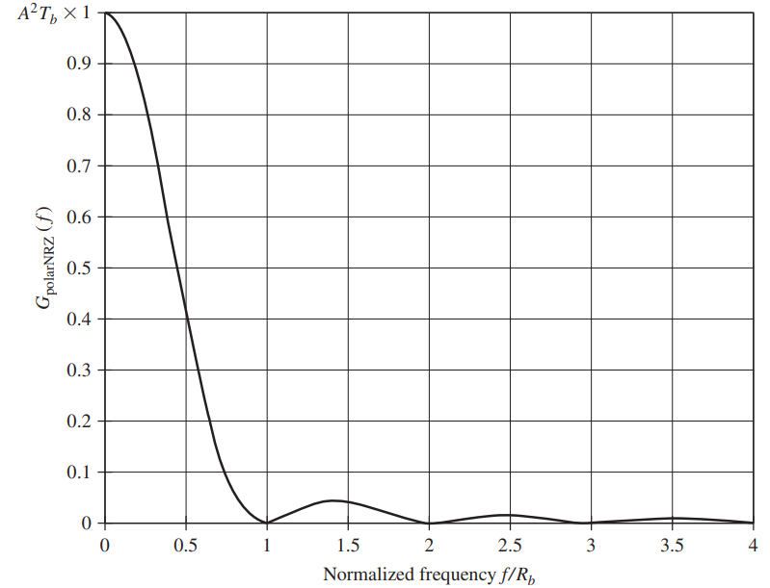
Polar NRZ-level

Slide 17
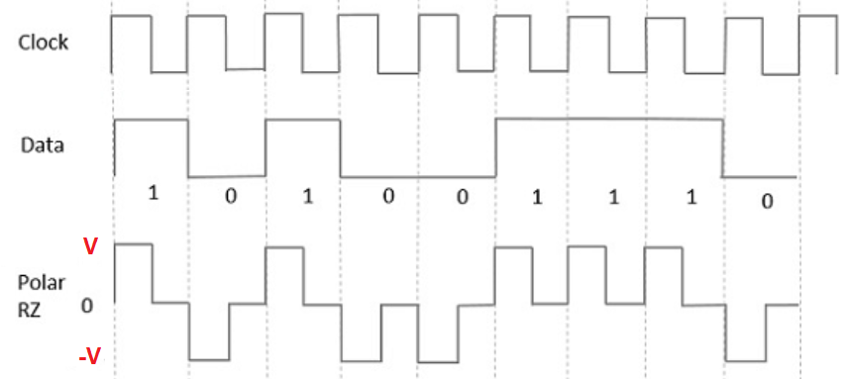
4. Polar Return-to-Zero (RZ) signaling
In this type of Polar signaling, a High in data, though represented by a Mark pulse, its duration T₀ is less than the symbol bit duration. Half of the bit duration remains high but it immediately returns to zero and shows the absence of pulse during the remaining half of the bit duration.
However, for a Low input, a negative pulse represents the data, and the zero level remains same for the other half of the bit duration. The following figure depicts this clearly.

Slide 18
Advantages
It is simple.
No low-frequency components are present.
Disadvantages
No error correction.
No clock is present.
Occupies twice the bandwidth of Polar NRZ.
The signal droop is caused at places where the signal is non-zero at 0 Hz.

Slide 19
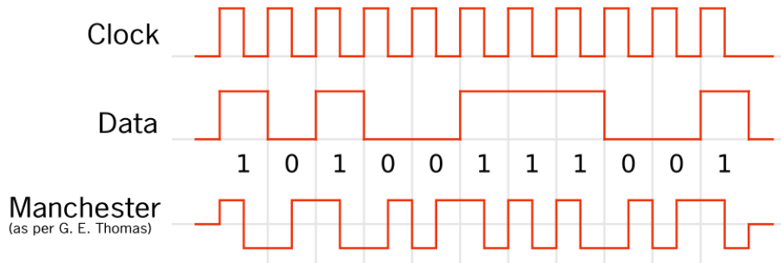
5. Split-phase (Manchester code)
Symbol 1 is represented by a positive pulse of amplitude A followed by a negative pulse of amplitude -A, with both pulses being of half-symbol width.
For symbol 0, the polarities of these two pulses are reversed

Slide 20
Advantages:
Manchester code ensures frequent line voltage transitions, directly proportional to the clock rate; this helps clock recovery.
The DC component of the encoded signal is not dependent on the data and therefore carries no information. Therefore, allowing the signal to be conveyed conveniently.
Disadvantages:
Manchester coding's data rate is only half that of a non-coded signal, which limits its usefulness to systems where bandwidth is not an issue, such as a LAN vantages.
Manchester encoding introduces difficult frequency-related problems that make it unsuitable for use at higher data rates.

Slide 21
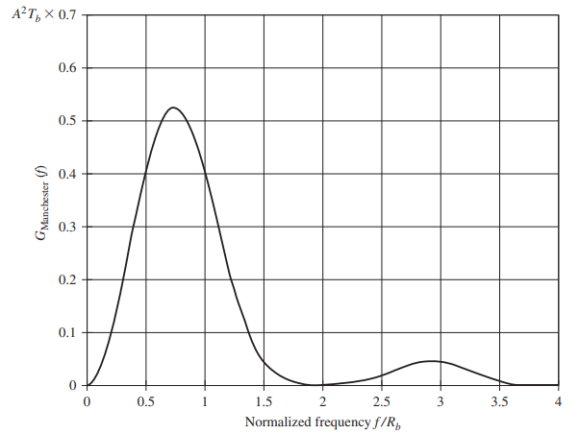
5. Split-phase (Manchester code)
The Manchester code suppresses the dc component and has relatively insignificant low-frequency components, regardless of the signal statistics.
In Manchester encoding, the transition at the middle of the bit is used for both synchronization and bit representation

Slide 22
End

